Slide 1


CRVS Systems Improvement
Framework and Application
Dr. Mturi Elias,
Enterprise Architect & BPI Expert
Deputy Managing Director,
University of Dar es Salaam Computing Centre
emturi@{udsm.ac.tz, gmail.com}

Slide 2
Outline of the Presentation
The CRVS Systems Improvement Framework
Application of the CRVS Systems Improvement Framework
Introduction to BPI as Applied to CRVS Improvement

Slide 3
Objectives of the Training
  To introduce the basic principles of business process improvement (BPI) applied to CRVS systems improvement
  Helps participants develop skills needed to apply BPI to CRVS systems improvement

Slide 4
Learning Objectives
  Understand the foundational concepts of business process improvement applied to CRVS improvement
  Map and document business process using standard modelling notation
  Perform analysis of existing CRVS business process to identify major bottlenecks in the country
  Perform redesign of CRVS business process to improve CRVS system in the country

Slide 5
CRVS Systems Improvement
Module 1: Introduction to Business Process Improvement as Applied to CRVS

Slide 6

Introduction

Slide 7
Introduction
Outline of the Presentation
  What is a Business Process
  Organization Vision, Process and Capabilities
  What is Business Process Improvement (BPI)?
  BPI and the Service Quality
  CRVS Systems Improvement Overview

Slide 8
What is a Business Process?

Slide 9
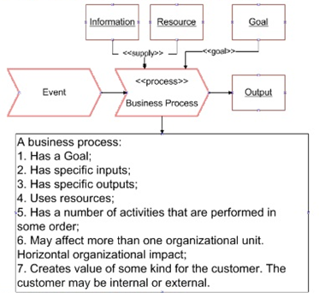
What is a Business Process (BP)?
  BP is a collection of related, structured activities or tasks that produce a specific service or product (serve a particular goal) for a particular customer or customers.

Slide 10
What is a Business Process (BP)?
  Examples of BP, in the context of Government, are:
  Issuance of a Driving License or Passport
  Registration of a Company
  Audit of a Tax Return
  Release of a Grant

Slide 11
CRVS Business Processes
  Example of CRVS business processes:
  Birth Registration in the Community
  Birth Registration in a Health Facility
  Death Registration in the Community
  Death Registration in a Health Facility
  Marriage Registration
  Divorce Registration

Slide 12
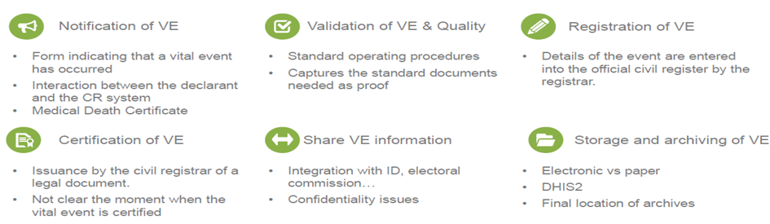
CRVS Sub-Processes

Slide 13
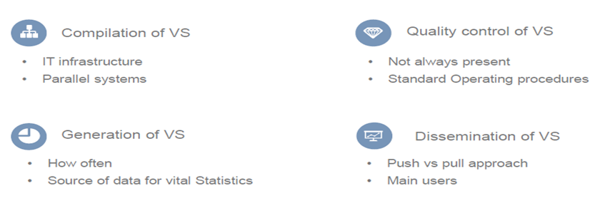
CRVS Sub-Processes

Slide 14
Organization Vision, Process and Capabilities

Slide 15
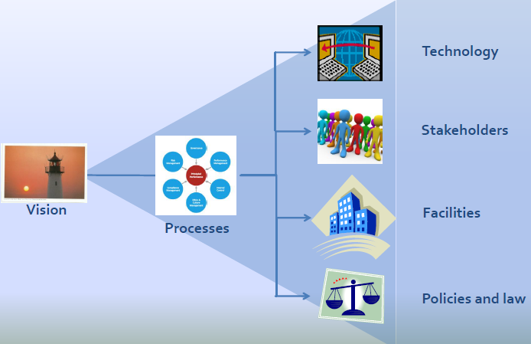
Organization Vision, Processes and Capabilities
  Business processes are critical organizational assets that are performed to achieve organization’s vision
- Benjamin Tan

Slide 16
Organization Vision, Processes and Capabilities
  Therefore to the large extent the organization’s success depends on how well its business processes are designed and performed
  Business processes are the basis for determining what the capability requirements are, as shown in Figure 2
  Capabilities are ability and capacity of an organization expressed in terms of its human resources, physical and material resources, financial resources,

Slide 17
What is Business Process Improvement?

Slide 18
What is Business Process Improvement (BPI)?
  According to Techopedia, Business process improvement (BPI)
  "is an approach designed to help organizations redesign their existing business operations to accomplish significant improvement in production. Effective BPI helps to generate promising results in operational efficiency and customer focus.”

Slide 19
BPI and Service Quality

Slide 20
BPI and Service Quality
  Service Quality is an important concept to be kept in mind while undertaking BPI initiatives.
  Service Quality comprises of the physical Product or service, the Time taken to deliver it, the Cost of getting the service, and Customer Experience or Service Delivery.
  A BPI exercise should identify the Service Quality Parameters associated with the service being redesigned, and strive to improve those parameters.

Slide 21
BPI and Service Quality
  To illustrate service quality, let us take the example of the Birth Registration in the Community process.
  At first glance the most tangible product in Birth Registration in the Community process is the physical birth certificate itself.

Slide 22
BPI and Service Quality
  There are various parameters by which the quality of the physical product can be measured:
  Name of the child and name(s) of the parent(s) are correct
  Personal information like sex, date of birth, place of birth, address, and parent's information are correct
  The certificate is signed by civil registrar and is valid
  Physical birth certificate is as expected

Slide 23
BPI and Service Quality
  But for a customer, the Service Quality is dependent on a lot of other factors apart from the Physical product.
  These include a host of factors, including the following:

Slide 24
BPI and Service Quality
  Time: time taken for completion of service by the customer, time taken for delivery of service by the Government
  Cost: Cost incurred in receiving the service by the customer
  Complexity (illustrative): Number of forms to be filled, amount of information to be provided, number of offices to be approached by the customer, etc.

Slide 25
BPI and Service Quality
  Transparency: Knowledge on process for delivery of service, delivery timelines, status of service request to citizen
  Citizen Experience: Quality of interactions (courtesy, politeness, treatment) with the government during service delivery

Slide 26
CRVS Systems Improvement Overview

Slide 27
CRVS Systems Improvement Overview
  There has been an increased global momentum and commitment towards CRVS systems improvement.
  Many countries are systematically assessing their CRVS systems.
  In some countries, national-level committees have been established to oversee CRVS systems improvement.

Slide 28
CRVS Systems Improvement Overview
  Despite the these efforts
  Many countries do not have a well-functioning civil registration and vital statistics (CRVS) systems in place.
  CRVS Systems of most countries are still characterized by complex structures where individual institutions work in their respective silos.
  This follows from the fact that many of the CRVS processes are inefficient and obsolete.

Slide 29
CRVS Systems Improvement Overview
  In most countries, the current CRVS processes were defined with compliance in mind, rather than enhanced citizen service.
  It is critical that any effort to improving CRVS systems must ensure that CRVS business processes are well designed
  This calls for adoption of Business Process Improvement Approach for CRVS Systems Improvement.

Slide 30

Discussion
  Introduction: Q&A

Slide 31
CRVS Systems Improvement
Module 2: The Improvement Framework

Slide 32
The CRVS Systems Improvement Framework

Slide 33
The CRVS Systems Improvement Framework
Outline of the Presentation
  Overview of the Framework
  The Framework

Slide 34
The CRVS Systems Improvement Framework
Stage 1: CRVS Systems Improvement Planning
Tasks | Applicable Tools | Deliverables
1.1: Identify and communicate the need for improving CRVS systems | This Guide | Base case for CRVS systems improvement
1.2: Establish effective leadership and governance for CRVS and CRVS improvement team | This Guide | Governance structure, Core team, work plan & resources
1.3: Establish stakeholder engagement plan | The Guide | Stakeholders engagement plan

Slide 35
The CRVS Systems Improvement Framework
Stage 2: CRVS Landscape Analysis
Tasks | Applicable Tools | Deliverables
2.1: Conduct desk review for CRVS systems | Evaluation tools
2.2: Map existing CRVS business processes | This Guide | As-Is CRVS business process maps
2.3:Analyze existing (As-Is) CRVS business processes | This Guide | Process issues, bottlenecks, root causes and improvement recommendations
2.4: Benchmark your CRVS processes with international principles and recommendations and, and best practices | This Guide | Comparison of your CRVS processes and performances with best practice

Slide 36
The CRVS Systems Improvement Framework
Stage 3 - Improve the CRVS Business Processes
Tasks | Applicable Tools | Deliverables
3.1: Redesign a better process | This Guide | To-Be business process maps
3.2: Validate redesigned (to-be) process with stakeholders | This Guide | Validated To-Be business process map

Slide 37
The CRVS Systems Improvement Framework
Stage 4 - Review or Formulate the CRVS Strategic Plan
Tasks | Applicable Tools | Deliverables
4.1: Review or formulate a CRVS Strategic Plan | CRVS improvement strategic plan, This document | CRVS strategic plan
4.2: Review or develop a CRVS action plan along with the monitoring and evaluation plan | ECA CRVS online monitoring tool (ECA), CRVS costing tool | Costed action plan (include the cost for change management plan implementation)

Slide 38
The CRVS Systems Improvement Framework
Stage 5 - Implement the Improvement
Tasks | Applicable Tools | Deliverables
5.1: Acquire the required resources and capabilities as per the action plan | Digitization guidebook, legal framework review tool (VS), | Acquired resources and capabilities (i.e. New or redesigned CRVS Digital System, Revised legal framework)
5.2: Prepare and implement a change management plan |  | Change management plan
5.3: Roll out the new CRVS business processes | This Guide | New process into production

Slide 39
The CRVS Systems Improvement Framework
Stage 6 - Monitor, evaluate and Improve Continuously
Tasks | Applicable Tools | Deliverables
6.1: Implement the system to monitoring performance of the CRVS process | Online monitoring tool (ECA), CRVS performance matrix (VS) | Performance monitoring system (i.e. dashboard)
6.2: Continually monitor, evaluate and improve the CRVS process performance

Slide 40
Discussion
  CRVS Improvement Framework: Q&A

Slide 41
CRVS Systems Improvement
Module 3: Practical Application of The Improvement Framework

Slide 42
Practical Application of The Improvement Framework

Slide 43
Stage 1:Plan CRVS Systems Improvement
Task 1.1: Identify and communicate the problem
Task 1.2: Establish Effective CRVS Governance
Task 1.3: Establish stakeholders engagement plan

Slide 44
Task 1.1: Identify and Communicate the Problem

Slide 45
Task 1.1: Identify and Communicate the Problem
Step 1: Identity and communicate the need for CRVS systems improvement
CRVS systems improvement efforts are mainly triggered to:
Address the needs of the customers (citizens) and the government
Address the specific concerns of the stakeholders
Address the challenges and issues in the services and service delivery
Improve the quality of the services or products
Adopt best practices
Step 2. Obtain buying and support from high-level national CRVS leadership

Slide 46
Task 1.2: Establish Effective CRVS Governance and Iprovement Team

Slide 47
Task 1.2: Establish Effective CRVS Governance and Improvement Team
Step 1. Establish appropriate CRVS governance structure and mechanisms
Step 2: Establish a multi-disciplinary CRVS improvement core team with the requisite skills and expertise
Step 3: Define work plan, timeline and acquire resources for completing the work

Slide 48
Task 1.3: Establish stakeholders engagement plan

Slide 49
Task 1.3: Establish stakeholders engagement plan
Step 1. Identify and understand CRVS stakeholder groups and customers that should to be involved
Step 2. Develop the approach to managing these groups
Step 3. Define the points at which stakeholder consultation will occur

Slide 50
Discussion
Planning CRVS Improvement: Q&A

Slide 51
Stage 2:Analyze CRVS Systems
Task 2.1: Conduct Desk Review
Task 2.2: Map Existing CRVS Processes
Task 2.3: Analyze the CRVS Processes
Task 2.4: Benchmark the CRVS Processes

Slide 52
Task 2.1: Conduct Desk Review

Slide 53
Task 2.1: Conduct Desk Review
Step 1: Define the framework for reviewing documents
Step 2: Collect and review relevant document and materials
  Step 3: Conduct analysis
  Step 4: Develop and present the report to stakeholders

Slide 54
Task 2.2: Map Existing CRVS Business Processes

Slide 55
Task 2.2: Map Existing CRVS Processes
Step 1: Identify and describe all the CRVS business processes
Step 2: Identify process owners and process participants
Step 3: Interview process owners and process participants
Step 4: Interview and generate the map
Step 5: Creating the final map
Step 6: Review of the final process maps by some key CRVS employees

Slide 56
  Step 4: Interview and generate the map
  Meet with CRVS Process Owners/Manager(s).
  Bring key process participants in the process mapping workshop.
  Members list all known process steps tasks and activities that they do. (See Table 2, Appendix 1)
  Members list all known process actors who perform the work. (See Table 3, Appendix 1)
  Review process with whole group and add additional information as necessary.

Slide 57
  Step 4: Interview and generate the map
  Immediately assemble the information that has been provided into a Process Map (See Figure 1, Appendix 1; & Appendix 2).
  Get agreement that the map represents the actual process as it is understood by the team

Slide 58
Discussion
Group Work: Process Mapping

Slide 59
Task 2.3: Analyze Existing CRVS Processes

Slide 60
Analyze the Existing CRVS Processes

Slide 61
Task 2.3: Analyze Existing CRVS Processes
Step 1: Gather process performance information
Step 2: Analyse the data to identify problems and issues of existing processes
  Step 3: Identify the root cause of the identified problems and issues
  Step 4: Identify and analyze Non Value Added (NVA) activities
  Step 5: Analyze process complexity
  Step 6: Analyse CRVS milestones
  Step 7: Document the identified performance issues

Slide 62
Step 1: Gather Process Performance Data
Determine the process performance data to be collected
        In order to decide which data to collect, it is essential to define the relevant measures:
          Measures of Excellence (MoE) - metrics which are Customer centric
          Measures of Performance (MoP) - metrics which are Stakeholder centric
      Field visit and data collection (See Table 5 and Table 6, Appendix 1)

Slide 63
Step 2: Analyze the Data
  Analyze the process performance data collected to identify problems and issues (See Table 7, appendix 1)

Slide 64
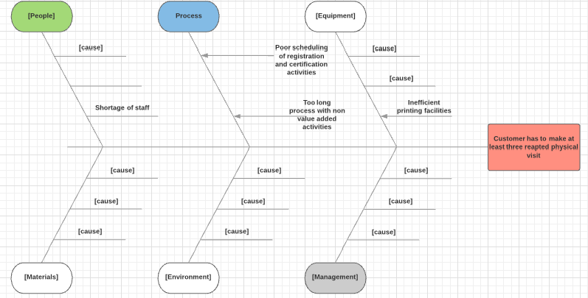
Step 3: Identify the root cause

Slide 65
Discussion
  Group Work: Papua New Guinea, Philippines, Cambodia, and Sri Lanka

Slide 66
Group work and Discussion
  Goal of this assignment is to apply the techniques of business process analysis to analyse selected business processes from four countries
  Identify bottlenecks and problems affecting/affected their CRVS performance
  Identify the root cause of identified bottlenecks and problems

Slide 67
Task 2.4: Benchmark your CRVS processes with international principles and recommendations and, and best practices

Slide 68
Benchmark CRVS Processes

Slide 69
Task 2.4: Benchmark CRVS Processes
Step 1: Identify international principles and best practices for CRVS systems
Step 2. Analyze information and data
  Step 3: Make improvement recommendations

Slide 70
Stage 3:Improve CRVS Business Processes
Task 3.1: Redesign a better process
Task 3.2: Validate redesigned (to-be)
process with stakeholders

Slide 71
Task 3.1: Redesign a better process

Slide 72
Task 3.1: Redesign a Better Process
Step 1: Identify and envision potential redesign ideas to create a better process.
  Step 2: Determine how to measure the new process's performance
  Step 3: Create a desired (to-be) process map
Step 4: Test the proposed redesign ideas
Step 5: Examine the implications of potential redesign

Slide 73
Step 1: Identify and envision potential redesign ideas to create a better process.
Drawing from stakeholder interviews, benchmarking, and other analysis activities, brainstorms ways to make the process better to address identified problems and issues
      How can the process be designed to reduce the number of physical visits (Exceed customer experience)
    How can the process be improved to ensure that all declared death are registered and certified (Exceed stakeholder experience)

Slide 74
Step 1: Identify and envision potential redesign ideas to create a better process.
Apply Process innovation techniques to identify redesign ideas and design a new process. (See typical techniques, in Appendix Table 1, Appendix 3)
For example Table 8 (in Appendix 1) provides example redesign ideas that address performance issues, documented in Table 7 (in Appendix 1) of, existing process for the death registration in the community in Tanzania.

Slide 75
Step 2: Determine how to measure the new process's performance
Determine how to measure the new process's performance.
Review the performance metric identified in the analysis stage and
Set new performance targets for the new process (See example Table 9, Appendix 1)

Slide 76
  Step 3: Create a desired (to-be) process map
  Create the desired (to-be) business process map based on the redesign ideas generated from step 1.
  To-Be process map shown in Figure 3 (Level 1); Figure 4 and Figure 5 (Level 2)

Slide 77
Step 4: Test proposed redesign idea
  Consider these testing mechanisms:
  Role-playing. Have team members act out the proposed process to see how well it works.
  Practice. have the people who would actually be carrying the real process try turning those inputs into outputs.
  Computer simulation: make use of the software to test proposed processes under various scenarios to find bottlenecks and other problems.

Slide 78
Step 5: Examine the implications of potential redesign
  Together with key stakeholders examine the organizational ramifications of the redesign,
  to determine the feasibility of the redesign process.
  Discuss how the new process might affect your CRVS structures, employees, citizens and systems.

Slide 79
Step 6: Document (to-be) business processes
  The documentation should include
  business processes definition,
  process maps and
  process narration.
  The process definition should include the CRVS business objective, business rules and performance measures.

Slide 80
Task 3.2: Validate redesigned (to-be) process with stakeholders

Slide 81
Task 3.2: Validate (To-be) CRVS Processes
  Step 1: Conduct a stakeholder workshop to validate the to-be business processes
  Step 2: Refine and document the redesigned (to-be) business processes
  Step 3: Obtain endorsement of the redesigned (to-be) business processes

Slide 82
Assignment & Discussion
  Group Work: Papua New Guinea, Philippines, Cambodia, and Sri Lanka

Slide 83
Stage 4 - Review or formulate the CRVS strategic plan
Task 4.1: Review or formulate the strategic plan
Task 4.2: Review or develop a national CRVS action plan

Slide 84
Task 4.1: Review or formulate the strategic plan

Slide 85
Task 4.1: Review or formulate the strategic plan
  Step 1: Define the desired CRVS outcome
  Step 2: Develop an initial CRVS vision
  Step 3: Identify resources and capabilities required to deliver the vision
  Step 4: Assess opportunities and gaps
  Step 5: Refine the vision and develop strategic recommendations
  Step 6: Obtain endorsement and communicate strategic plan to stakeholder

Slide 86
Task 4.2: Review or develop a national CRVS action plan

Slide 87
Task 4.2: Review or develop CRVS action Plan
  Step 1: Determine the approaches and options to acquiring identified resources and capabilities
  Step 2: Identify the high-level activities required to deliver the required resources and capabilities
  Step 3: Develop the action plan for each required resource or capability
  Step 4: Estimate the magnitude of funding required to implement the action plan

Slide 88
Assignment & Discussion
  Group Work: Papua New Guinea, Philippines, Cambodia, and Sri Lanka

Slide 89
Stage 5 - Implement the improvements
Task 5.1: Acquire the required resources and capabilities
Task 5.2: Prepare a change management plan
Task 5.3: Roll out the new CRVS business processes

Slide 90
Task 5.1: Acquire Required Resources and Capabilities

Slide 91
Task 5.1: Acquire Required Resources and Capabilities
  Step 1: Determine the potential availability of funding
  Step 2: Refine the action plan based on funding constraints
  Step 3: Define implementation phases of the action plan
  Step 4: Implement the action plan to acquire the required resources and capabilities

Slide 92
Task 5.2: Prepare and implement change management Plan

Slide 93
Task 5.2: Prepare and implement a Change Management Plan
  Step 1: Identify the expected type and scope of change
  Step 2: Identify implementation obstacles
  Step 3: Develop a change management plan
  Step 4: Create a change management team

Slide 94
Task 5.3: Roll out the new CRVS business processes

Slide 95
Task 5.3: Roll out the new CRVS business processes
  Step 1: Communicate the changes and plan to all stakeholders
  Step 2: Conduct required training
  Step 3: Pilot in a selected district
  Step 4: Use the feedback from pilot to refine
  Step 5: Scale up the implementation

Slide 96
Discussion
  Discussion: Q&A

Slide 97
Stage 6: Monitor, Evaluate and Continuously Improve CRVS Processes
Task 6.1: Implement CRVS performance monitoring and evaluation system
Task 6.2: Continually monitor, evaluate and improve the CRVS process performance

Slide 98
Task 6.1: Implement CRVS performance monitoring and evaluation system

Slide 99
Task 6.1: Implement CRVS performance monitoring and evaluation system
  Step 1: Refine process performance metric or indicators and targets
  Step 2: Establish baseline for the selected metrics or indicators
  Step 3: Define data collection methods and timeline
  Step 4: Implement the CRVS performance monitoring and evaluation system

Slide 100
Task 6.2: Continually monitor, evaluate and improve the CRVS process performance

Slide 101
Task 6.2: Continually monitor, evaluate and improve the CRVS process performance
  Step 1: Continuously monitor and evaluate the performance of CRVS business processes
  Step 2: Identify bottlenecks
  Step 3: Take needed action to improve the performance
  Step 4: Communicate and report results of performance evaluation

Slide 102
CRVS Systems Improvement
THANK YOU

